Slide 1
HMH Science Dimensions
Biology
Unit 6: The Structure and Function of DNA
Notes:
The learning experiences in this unit prepare students for the mastery of
Performance Expectations
LS1-1 Construct an explanation based on evidence for how the structure of DNA determines the structure of proteins which carry out the essential functions of life through systems of specialized cells.

Slide 2

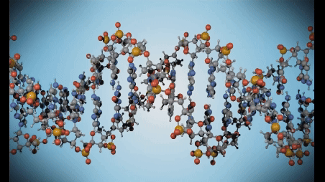
The Structure and Function of DNA
Unit 6
DNA is an essential molecule for all living things.

Slide 3


Driving Questions
Unit 6
As you move through the unit, gather evidence to help you answer the following questions:
How did scientists determine the structure of DNA?
How does the information in DNA get transferred into observable traits?
How is the flow of information from DNA regulated?

Slide 4

Unit Project
Unit 6
Case Study: Malformed Frogs
Can you explain how genes and proteins are related to the trend of malformations in frogs?

Slide 5
Unit Review
Unit 6
Synthesize the Unit
Make a concept map, other graphic organizer, or outline using the Study Guides you made for each lesson in this unit. Be sure to use evidence to support your claims.
When synthesizing individual information, remember to follow these general steps:
Find the central idea of each piece of information.
Think about the relationships among the central ideas.
Combine the ideas to come up with a new understanding.

Slide 6
Image Credits
Unit 6
DNA model video ©ommbeu/Fotolia

